Slide 1
Automatic Coil Winder
Max Jost, Martin Steiner, Aleksey Sokolov

Slide 2
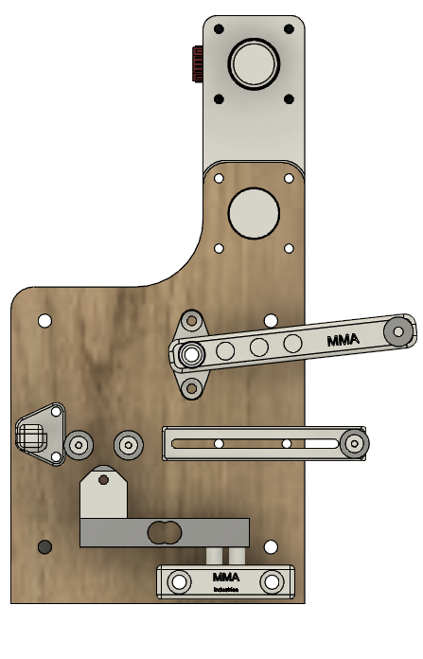

Slide 3
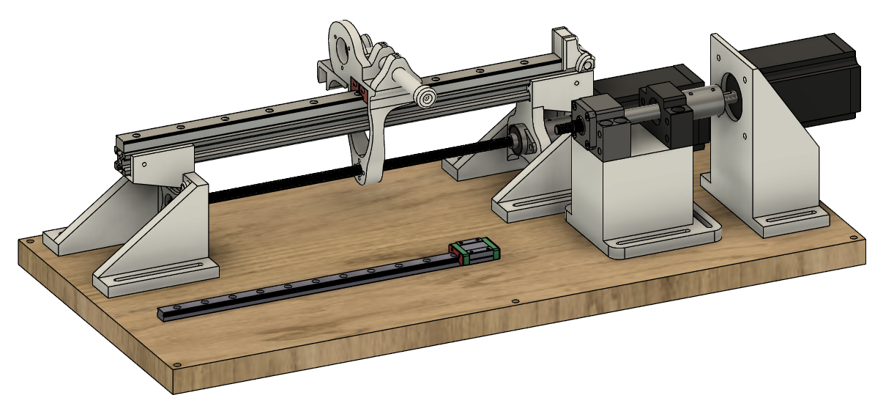

Slide 4
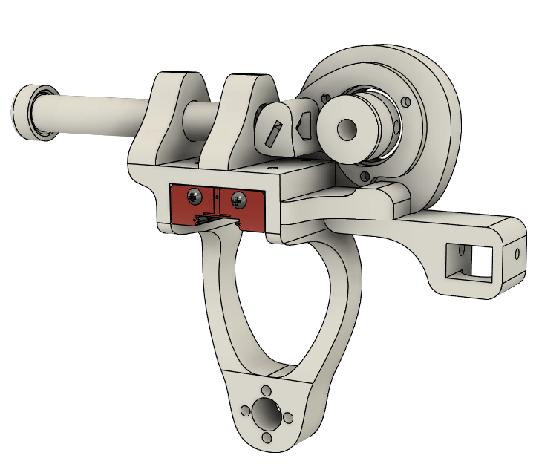

Slide 5
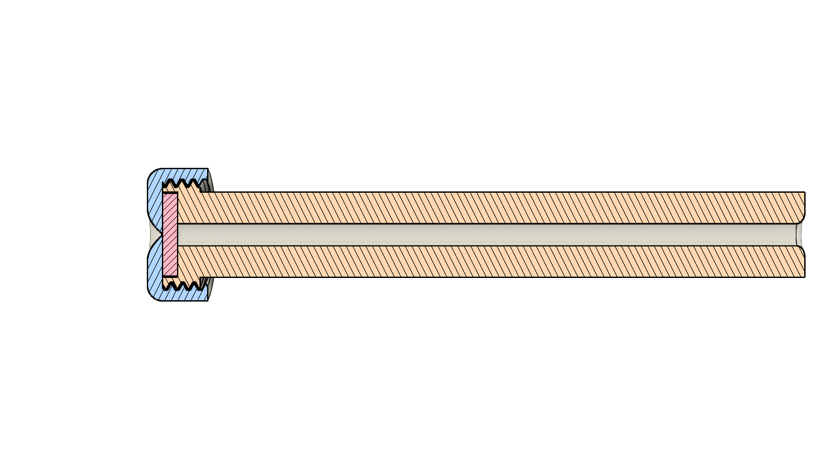

Slide 6
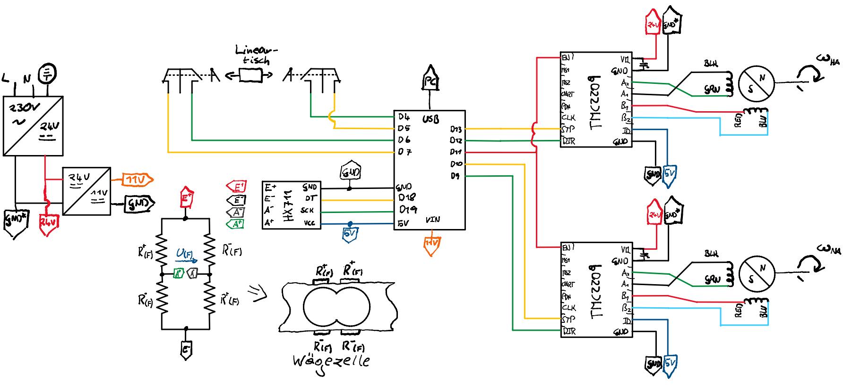

Slide 7
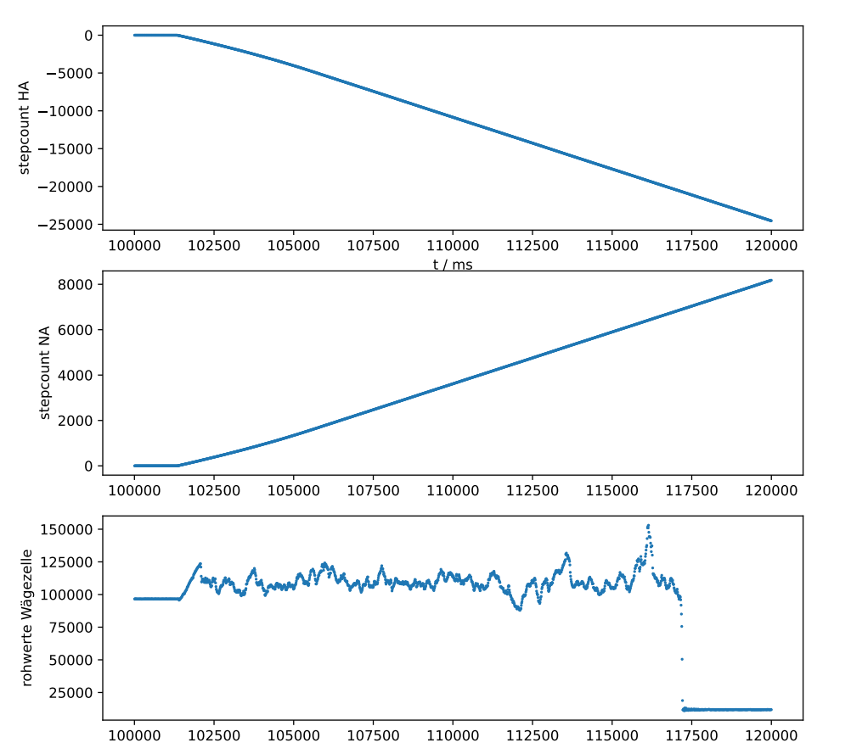

Slide 8
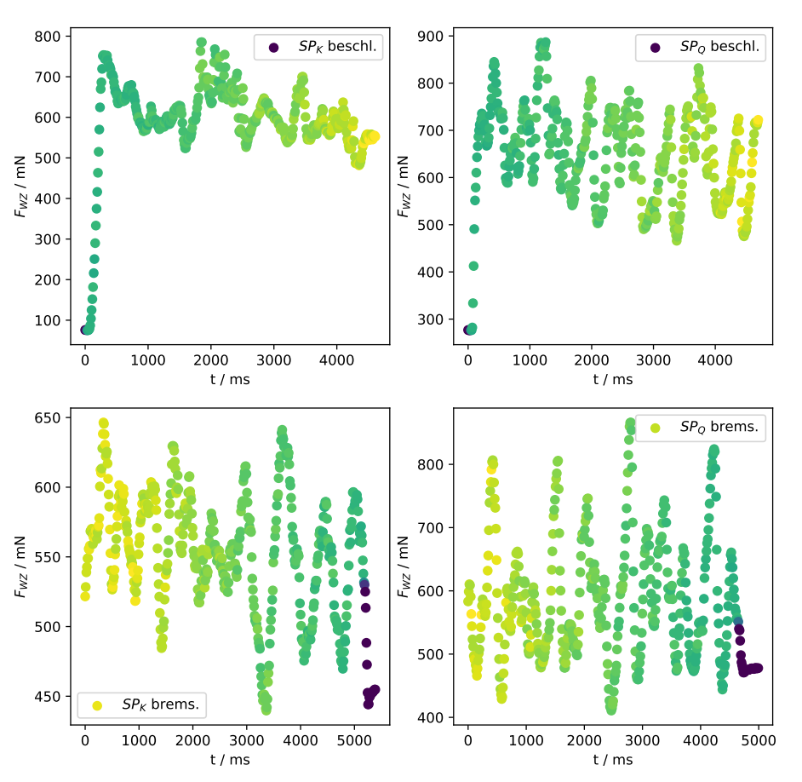

Slide 9
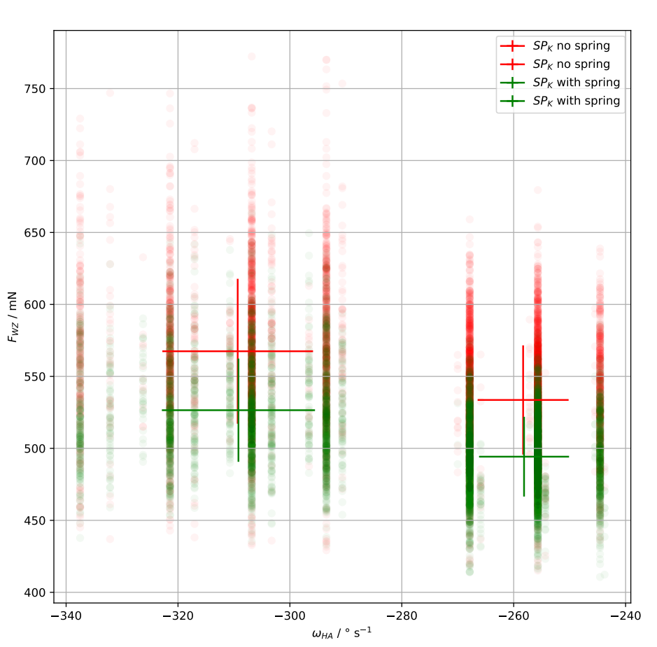

Slide 10
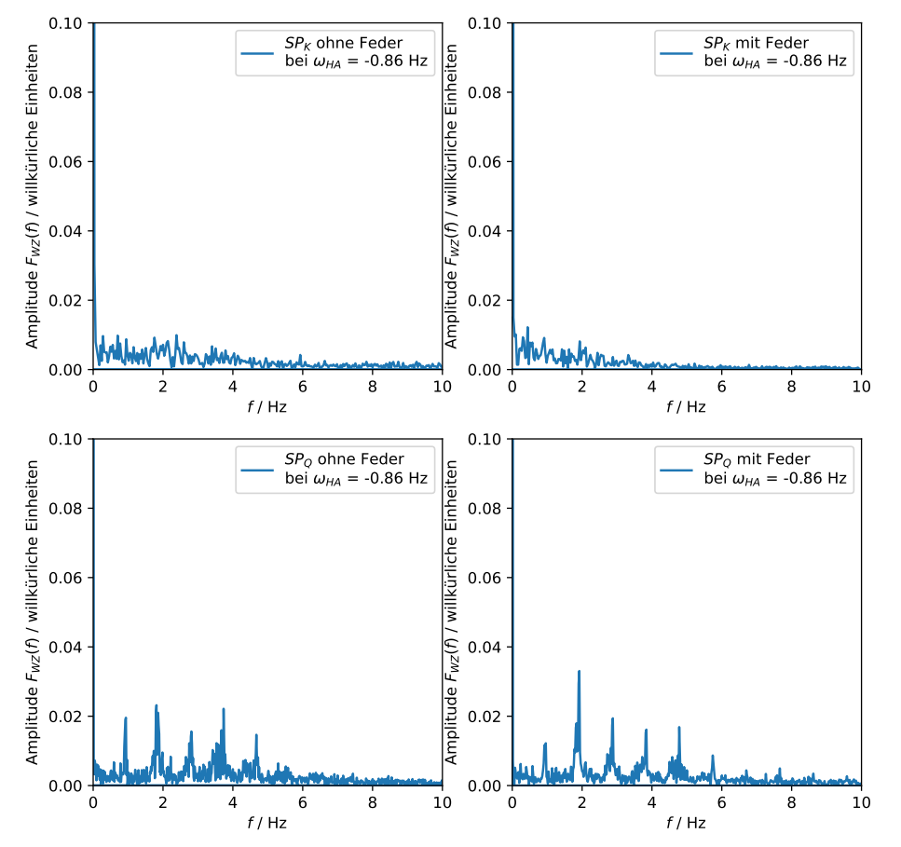

Slide 11

Endstopperkennung
int endstop = 0; // value is 0 if no endstop is reached
const int mask = 0b10100000;
int previous_endstopt_val = 0;
void EndstopRead() // NC_l pin5, NC_r pin7
{
byte b = (~PIND) & mask;
endstop = previous_endstopt_val & ~b;
previous_endstopt_val = b;
}
Eigentlich gilt $\overline{a}∧b$, da für die Endstopps in NO-Schaltung Pullups verwendet
=> $\overline{\left(\overline{a}\right)∧b}=a∨\overline{b}$

